Slide 1
Advanced Coaching Skills Practicum
Technique Builder
© 2006-2020 CoachingOutoftheBox®
Notes:
A development tool for you to track your insights and learnings

Slide 2
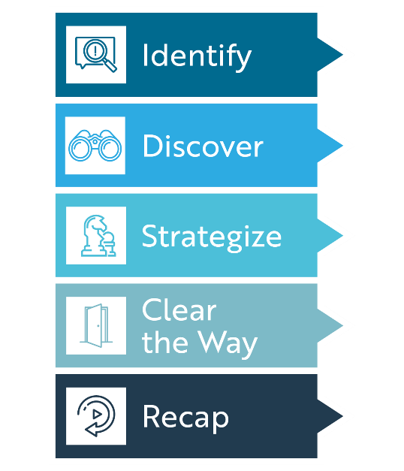
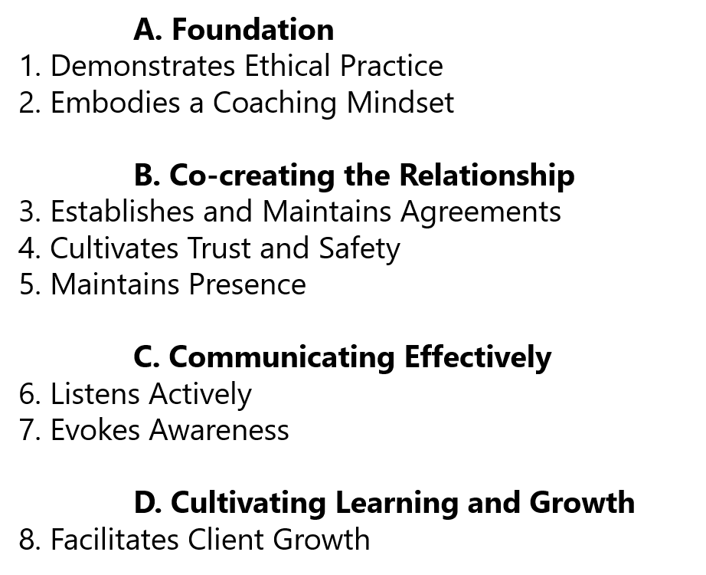
Expand Your Style
The 5 Step Coaching Exchange
The 5 Guiding Principles
The 5 Guiding Principles
Practice to integrate each of the twenty-three elements into your coaching style.
Challenge:
Be willing to engage in live coaching and open to expand your technique.
The 5 Core Coaching Skills
The ICF Core Competencies
Notes:
Set the tone for the next 8 weeks
Reminder of the 5/5/5 Model and the 15 elements that are contained in that model. Plus the 8 ICF Core Competencies (23 elements)
The Challenge for the entire course: Be willing to engage in live coaching and open to expand your technique.

Slide 3
How A Coach Demonstrates ICF Competencies
3. Establishes and Maintains Agreements
Agreements About Coaching Relationship |  | Agreements About The Coaching Session
Declares adhere to the ICF guidelines and standards. Reaches an agreement on what is the client’s and coach’s responsibilities. Discusses guidelines and specific parameters of the coaching relationship. Gains agreement on what is appropriate in the relationship and what is not. Reaches an agreement on what is, and is not being offered. |  | Determines an effective match of coaching methods and the needs of client. Fully explores what the client wants coaching on. Explores ideal outcomes for every coaching session. Is clear on what the client wishes to leave the session with. Discusses the parameters and importance of confidentiality.
6. Listens Actively | 7. Evokes Awareness
Listens without an agenda. Hears the client values, beliefs, feelings Distinguishes between the words, tone of voice and body language. Uses active listening tools Supports the client full expression. Integrates and builds upon what is being said. Understands the essence of what is being said. Helps the Client gain clarity and perspective rather than engaged in the story. Coach listens contextually. | Questioning |  | Direct Communication
 | Questions that reflect active listening. Questions that evoke discovery, insight, commitment or action. Open-ended questions that create greater clarity, possibility or new learning. Clear, direct, succinct questions. Help client discover & clarify greater possibilities. Questions are non-leading and non-judgmental. Questions that foster deeper awareness. Questions that do not imply the coach’s solution. |  | Reframes and articulates to help the client understand from another perspective. Uses respectful, neutral, appropriate language. Uses metaphor and analogy to help to illustrate a point or paint a verbal picture. Is clear, articulate and direct in questions, observations and feedback. Clearly states coaching objectives, meeting agenda, and purpose of techniques or exercises. Detached from expected outcomes or actions.
8. Facilitates Client Growth
Asks penetrating and evocative questions Goes beyond the words to examines meaning. Clearly expresses insights and observations without attachment. Challenges to evoke awareness. | Offers different / broader perspectives for Client. Coach gets to the source. Coach illuminate fixed ways of thinking. Identifying and acknowledging strengths. Coach makes distinctions. |  | Goes beyond immediate goal, to explore for discovery, perspective, learning and growth. Noticing what is said and what is done. Co-designs goals, actions, accountability, measures that integrate the learning. © 2006-2020 CoachingOutoftheBox®

Slide 4
Technique Builder
Growing by Observation | What did the Coach do really well? | What tip / technique do you want to add to your coaching style? | What action will I now take to enhance my coaching style.
COOTBX Recorded Coaching Exchange
Other Class Recordings
Growing by Coaching | As the Coach, what worked well? | As the Coach, what might you do differently?
My Observed Coaching 1
My Observed Coaching 2
Coaching my Practice Partner
Growing from Feedback | What did others say I did well? | What Feedback was valuable to me?
In-class coaching
Growing through Fieldwork | What did I learn about my coaching?
Re-reading the ICF Core Competencies
My recording I self-assessed
My partners recording I gave feedback on
Growing from Learning | What concept was I reminded I knew | What did I take away from the topic
“How A Coach Demonstrates” one page
Skill: Requesting
Other
© 2006-2020 CoachingOutoftheBox®

